Slide 1
Design Phase Presentation
25S12 – Hardware Accelerator of BWFA-MEM2 on Alveo U50 using HLS
Guide: Prof. Kuruvilla Varghese
Students: Sri Sai Nomula, Sai Charan Katakam

Slide 2
Outline
Motivation
Longest Common Subsequence (LCS)
Manhattan Tourist Problem
Sequence Alignment is the Manhattan Problem in Disguise
Space-Efficient Sequence Alignment
The Fast and Memory-Efficient Alignment Algorithm
HLS Component Development Flow
Role of Pragmas in HLS
Features of Alveo U50
Demo plan and demo setup
Status of the Project
Time Plan

Slide 3
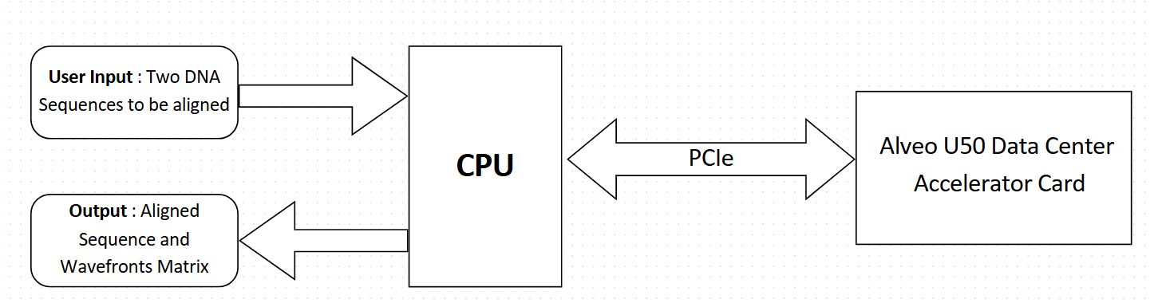
Aim of the Project
Design a novel data center card-based accelerator for the Bi-WFA algorithm.
The computation of wavefronts and junctions are done in the Alveo U50 and using this data, rest of the alignment is computed in the host CPU.

Slide 4
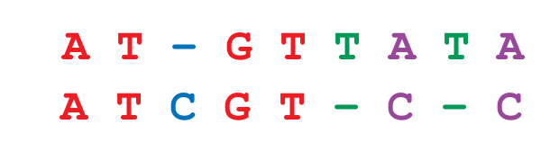
Longest Common Subsequence (LCS)
Subsequence can be consecutive or not, but it maintains the order in the string.
S1 = “A T G T T A T A” Generates 256 (2⁸) Subsequences.
S2 = “A T C G T C C ” Generates 128 (2⁷) Subsequences.
Among all these subsequences we need to find the Longest Common Subsequence.
The Longest Common Subsequence in S1 and S2 is “A T G T”.
There can be more than one Longest Common Subsequences among two sequences. Once of the Longest Common Subsequence is shown in Fig. 1
An alignment presents one possible scenario by which S1 could have evolved into S2.
Fig-1: Alignment of Sequences based on LCS

Slide 5
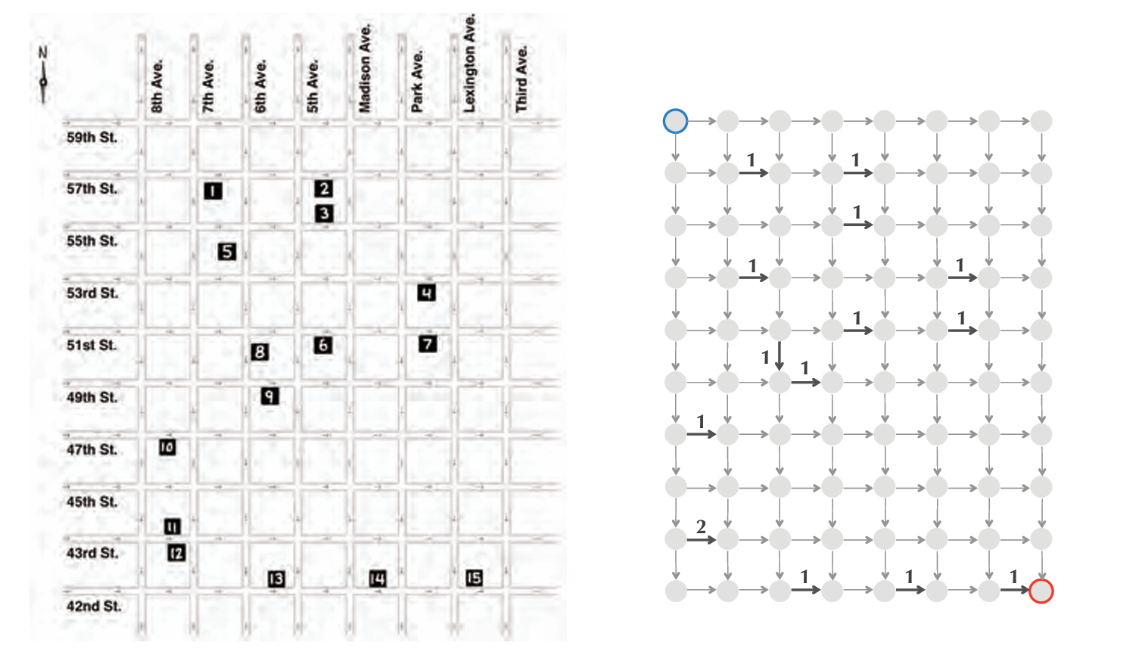
Manhattan Tourist Problem
The challenge of finding a legal path through the city that visits the most sights is called the Manhattan Tourist Problem.
We will represent the map of Manhattan as a directed graph Manhattan Graph in which we model each intersection as a node and each city block between two intersections as a directed edge indicating the legal direction of travel ( or )
We then assign each directed edge a weight equal to the number of attractions along the corresponding block. Adding the weights along a path from the source to the sink yields the number of attractions along that path.
To solve the Manhattan Tourist Problem we need to find a maximum-weight path connecting the source to the sink in Manhattan Graph.
Fig-2: Simplification of Midtown Manhattan

Slide 6
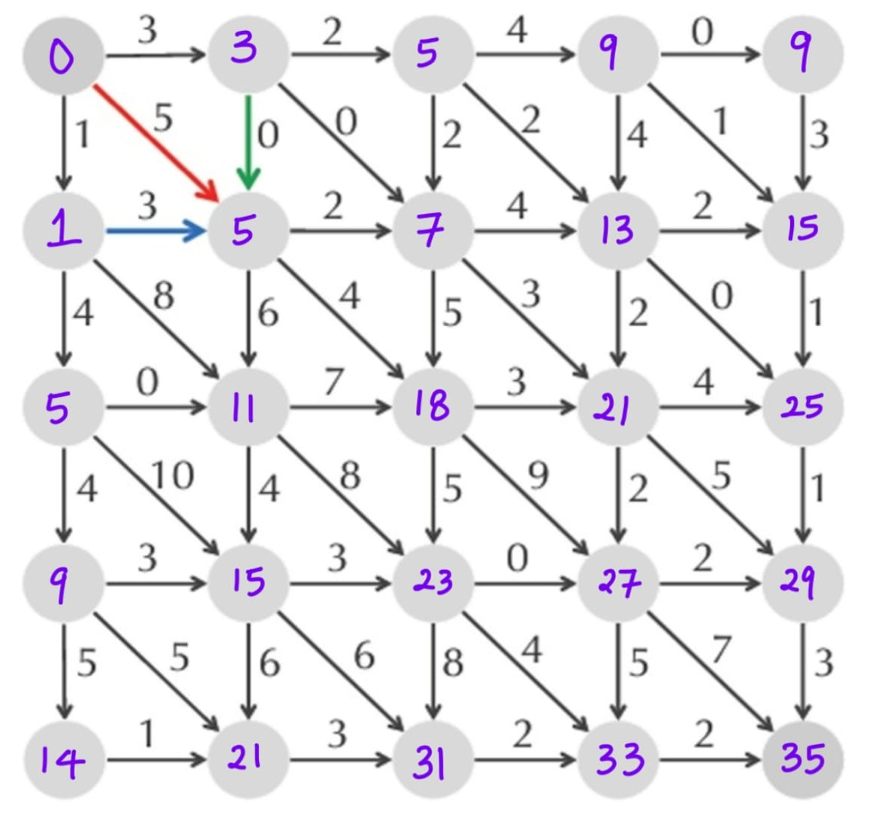
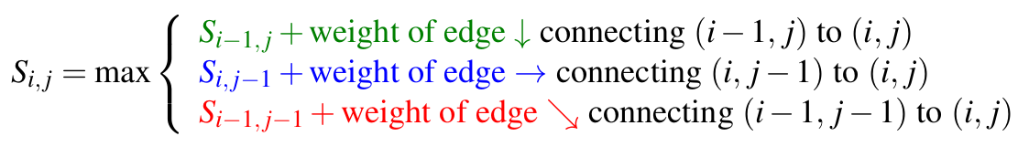
Sequence Alignment is the Manhattan Problem in Disguise
In addition to horizontal and vertical edges in Manhattan Tourist Problem, we have added diagonal edges connecting (i,j) to (i+1 , j+1) in Fig.3 .
Finding a longest common subsequence of two strings is equivalent to finding an alignment of these strings maximizing the number of matches.
To compute scores for any node (i,j) of this graph, we use the following recurrence:
Fig-3: Calculation of Maximum Length
Path to go from Source to Sink

Slide 7
Space-Efficient Sequence Alignment
The runtime of the dynamic programming algorithm for aligning two strings of lengths n and m is proportional to the number of edges in their alignment graph, which is O(nm). The memory required is also O(nm).
A divide-and-conquer algorithm often works when a solution to a large problem can be constructed from solutions of smaller problem instances. The divide phase splits a problem instance into smaller instances and solves them; the conquer phase stitches the smaller solutions into a solution to the original problem.
The idea of space reduction technique works in following steps:
Finding Middle Node of the Alignment.
Computing Alignment Score in Linear Space.

Slide 8
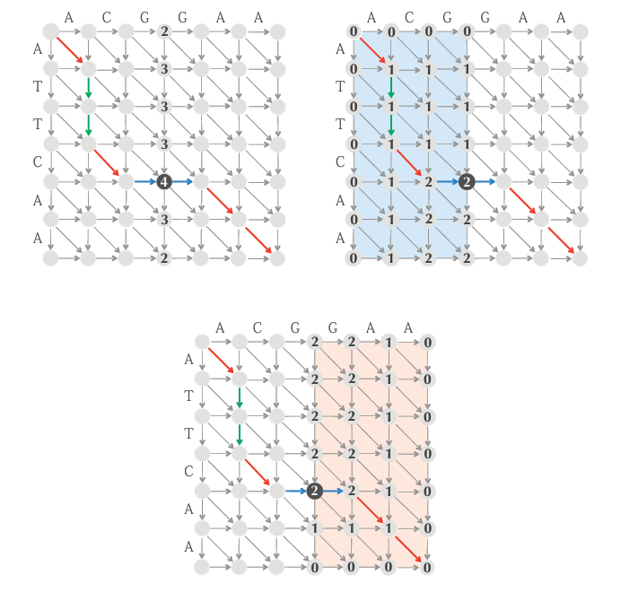
Finding Middle Node of the Alignment
Given Strings v = v₁ , v₂ ………. v_{n} and w = w₁ , w₂ ………. w_{m} define middle = m/2. A longest path from Source to Sink in the alignment graph must cross the middle column somewhere, and our first task is to figure out where using only O(n) memory.
In Figure 4, From (Top Left) we calculated middle = 3 (⌊m / 2⌋), and the alignment path crosses the middle column at the (unique) middle node (4,3) which has highest score in that column i.e., 4. Let FromSource(i) denote the length of the longest path from the source (0,0) to ending at (i,middle) and ToSink(i) denote the length of the longest path from (i,middle) to the sink (n,m).
Length(i) = FromSource(i) + ToSink(i)
Fig-4: Finding Mid Node based on two Scores
i.e., FromSource(i) and toSink(i).

Slide 9
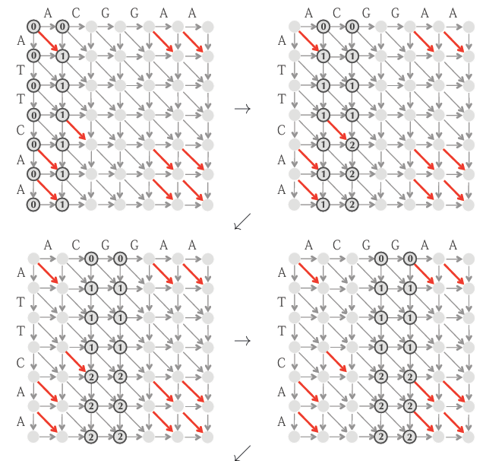

Computing Alignment Score in Linear Space
The space required can easily be reduced from the observation that only values needed to compute the alignment scores in column j are the alignment scores in column j-1. Therefore, the alignment scores in the columns before columns j-1 can be discarded when computing the alignment scores for column j, as illustrated.
Fig-5: Computing Alignment Scores in Linear Space

Slide 10
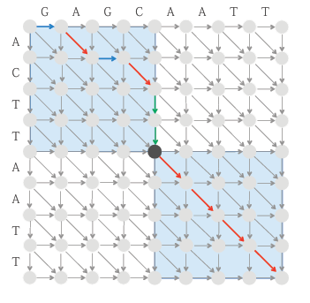
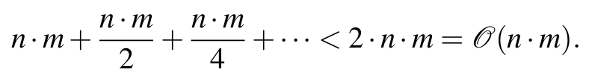
The Fast and Memory-Efficient Alignment Algorithm
Once we have found a middle node, we automatically know two rectangles through which a longest path must travel on either side of this node. As shown in Fig.6, one of these rectangles consist of all nodes above and to the left of the middle node, whereas the other rectangle consists of all nodes below and to the right of the middle node. Thus, the area of the two highlighted rectangles is half the total area of the alignment graph.
We can now divide the problem of finding the longest path from (0,0) to (n,m) into two subproblems i.e., Finding a longest path from (0,0) to the middle node and finding a longest path from the middle node to (n,m).
The Conquer step finds the two middle nodes within the smaller rectangles, which can be done in time proportional to the sum of areas of these rectangles, or n.m/2.
In general, at each new step before the final step, we double the number of middle nodes found while halving the time required to find middle nodes.
Proceeding in this way, we will find middle nodes of all rectangles in time equal to,
Fig-6: Divide and Conquer Approach to
find the Optimal Alignment.

Slide 11
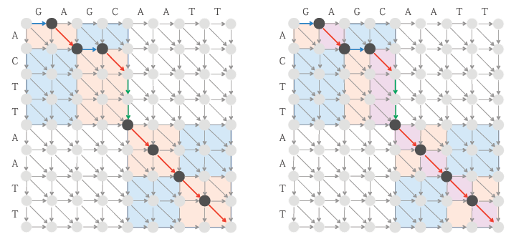

Thus, we have arrived at a linear-time alignment algorithm that requires only linear space.
Fig-7: Finding Middle Nodes within previously identified rectangles.

Slide 12
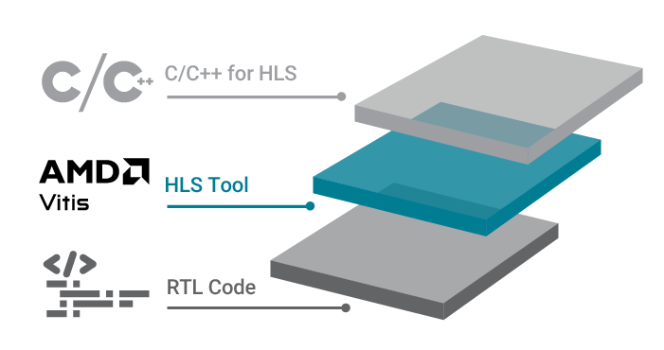
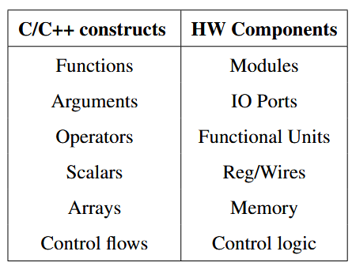
High-Level Synthesis (HLS)
High-Level Synthesis (HLS) is a technology that converts high-level behavioral descriptions of hardware into Register-Transfer Level (RTL) models. It leverages untimed functional descriptions, written in high-level programming languages such as C or C++, that focus on the functionality of the hardware without specifying the timing details of operations.

Slide 13

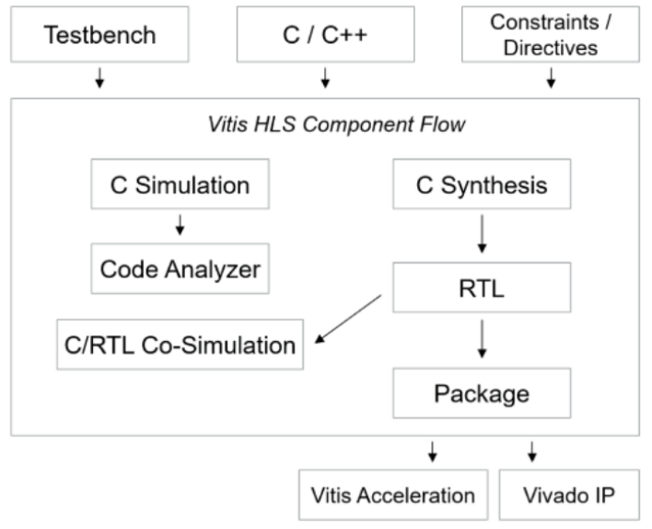
HLS Component Development Flow
Architect the algorithm based on the Design Principles.
(C-Simulation) Verify the functionality of the C/C++ code with the C/C++ test bench.
(Code Analyzer) Analyze the performance, parallelism, and legality of the C/C++ code.
(C-Synthesis) Generate the RTL using the v++ compiler.
(C/RTL Co-Simulation) Verify the RTL code generated using the C/C++ test bench.
(Package) Review the HLS synthesis reports and implementation timing reports.
Re-run previous steps until performance goals are met.

Slide 14
Role of Pragmas in HLS
In Vitis HLS, Pragmas serve as crucial directives or hints that empower the synthesis tool to translate high-level C++ code into efficient RTL hardware descriptions. They will give the following advantages,
Optimization
Latency Reduction
Throughput Performance
Area and Resource Usage
Examples of pragmas:
pragma HLS dataflow
pragma HLS interface
pragma HLS loop_tripcount
pragma HLS performance
pragma HLS pipeline
pragma HLS unroll

Slide 15
Non-Synthesizable Constructs of C/C++
The Software written for CPU runs sequentially one step at a time, whereas the software written for FPGA’s will exploit the parallelism and run more efficiently on the FPGA. A software which is well optimized for a CPU cannot be used directly for an FPGA, at least not before it is thoroughly checked, all the non-synthesizable parts of the code are replaced with the synthesizable counterparts. Usage of such constructs may cause issues during the design process. Here are few of them:
System Calls
Use of Dynamic Memory
Pointer Limitations
Recursive Functions

Slide 16
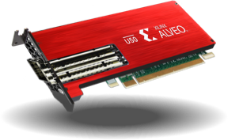
Features of Alveo U50
Card Component | Alveo U50
FPGA | UltraScale+™ XCU50 FPGA
PCIe | 16-lane PCI Express PCIe Integrated Endpoint block connectivity Gen1, 2, or 3 up to x16, Gen4 x8 Single or dual Gen4 x8
HBM | 8 GB - two 4 gigabyte (GB) HBM memory stacks Split into 32 256 MB channels
Network Interface | 1x QSFP28 Supporting 100 GbE, 40 GbE, or 4x10/25 GbE
I2C Bus | ✓
Status LEDs | ✓
Power Management | Power management with system management bus (SMBus) voltage, current, and temperature monitoring
Electrical Design Power | 75W PCIe slot functional with PCIe slot power only
Configuration Options | 1 gigabit (Gb) Quad Serial Peripheral Interface (SPI) flash memory UltraScale+ device configurable over USB/JTAG and Quad SPI configuration flash memory
UART | UART access through the maintenance connector

Slide 17
Project Specifications
Software Specifications
Sequences to be aligned – DNA Sequences
Length of reads – 64 base-pairs
Alignment type - Global
Input format – String of two DNA sequences
Output format - String of aligned sequences
User interface – Command Line Interface or Graphical- User Interface
Hardware Specifications
Alveo U50 Data Center Accelerator Card
Host Server Running Linux
Software interface - PCIe interface Gen3 16 lane

Slide 18
Demo Setup
Fig-9: Demo Setup of Bi-WFA using Alveo U50

Slide 19
Status of the Project
1
Implemented Bi-WFA in C++.
2
3
Tested and verified example code on Alveo U50 using Vitis HLS IDE.
Working on optimizing code for High-Level Synthesis.
Future Work
1
Implementing Bi-WFA using High Level Synthesis.
2
3
Testing with various Sequences and comparing the performance with various alignment algorithms.
Optimizing the Bottlenecks for better performance.

Slide 20
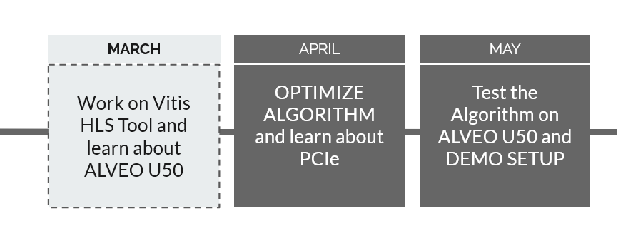
Time Plan

Slide 21
References
An Improved Algorithm for Matching Biological Sequences. Journal of Molecular Biology, 1982.
Fast gap-affine pairwise alignment using the wavefront algorithm.
An FPGA Accelerator of the Wavefront Algorithm for Genomics Pairwise Alignment. 31st International Conference on Field-Programmable Logic and Applications (FPL), 2021
An O(ND) Difference Algorithm and Its Variations.
Textbook, Bio informatics Sequence and Genome Analysis, David W. Mount University of Arizona, Tucson
DNA Sequencing
Optimal Gap-Affine Alignment in O(s) Space Bi-WFA Algorithm
Bioinformatics Algorithms : An Active Learning Approach

Slide 22
THANK YOU

